Slide 1
Chapter 6:
Multiple Sequence Alignment
Jonathan Pevsner, Ph.D.
pevsner@kennedykrieger.org
Bioinformatics and Functional Genomics
(Wiley-Liss, 3rd edition, 2015)
You may use this PowerPoint for teaching purposes

Slide 2
Learning objectives
Explain the three main stages by which ClustalW performs multiple sequence alignment (MSA);
Describe several alternative programs for MSA (such as MUSCLE, ProbCons, and TCoffee);
Explain how they work, and contrast them with ClustalW;
Explain the significance of performing benchmarking studies and describe several of their basic conclusions for MSA;
Explain the issues surrounding MSA of genomic regions

Slide 3
Outline: multiple sequence alignment (MSA)
Introduction; definition of MSA; typical uses
Five main approaches to multiple sequence alignment
Exact approaches
Progressive sequence alignment Iterative approaches
Consistency-based approaches
Structure-based methods Benchmarking studies: approaches, findings, challenges
Databases of Multiple Sequence Alignments
Pfam: Protein Family Database of Profile HMMs SMART Conserved Domain Database Integrated multiple sequence alignment resources MSA database curation: manual versus automated Multiple sequence alignments of genomic regions
UCSC, Galaxy, Ensembl, alignathon
Perspective

Slide 4
Multiple sequence alignment: definition
• a collection of three or more protein (or nucleic acid)
sequences that are partially or completely aligned
• homologous residues are aligned in columns
across the length of the sequences
• residues are homologous in an evolutionary sense
• residues are homologous in a structural sense

Slide 5
Example: 5 alignments of 5 globins
Let’s look at a multiple sequence alignment (MSA) of five globins proteins. We’ll use five prominent MSA programs: ClustalW, Praline, MUSCLE (used at HomoloGene), ProbCons, and TCoffee. Each program offers unique strengths.
We’ll focus on a histidine (H) residue that has a critical role in binding oxygen in globins, and should be aligned. But often it’s not aligned, and all five programs give different answers.
Our conclusion will be that there is no single best approach to MSA. Dozens of new programs have been introduced in recent years.

Slide 6
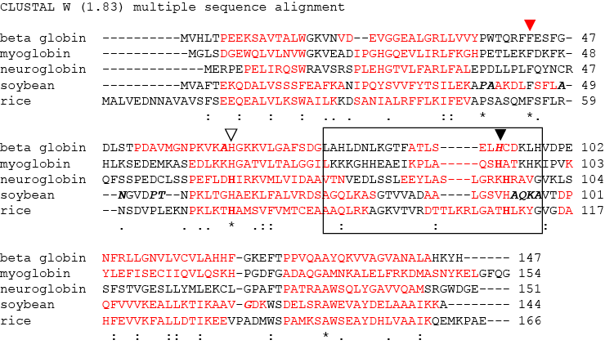
ClustalW
Note how the region of a conserved histidine (▼) varies depending on which of five prominent algorithms is used

Slide 7
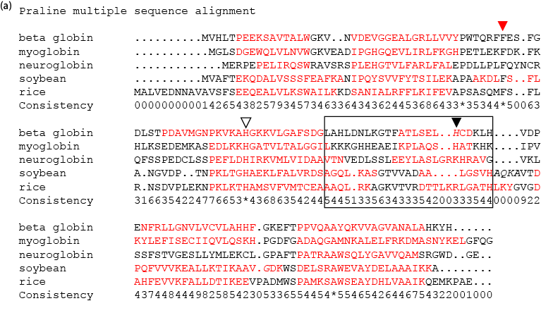
Praline
Note also the changing pattern of gaps within the boxed region in these five different alignments.

Slide 8
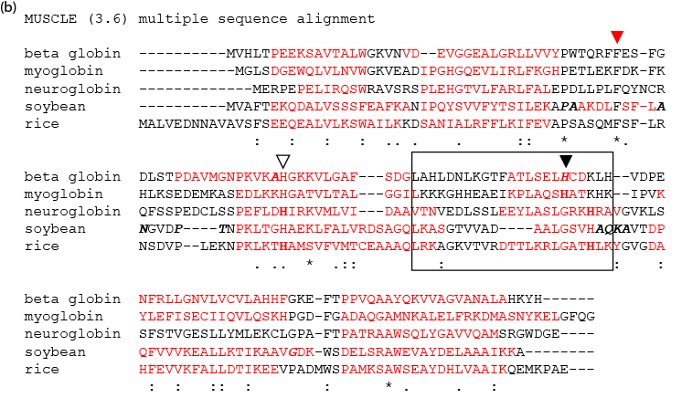
MUSCLE

Slide 9
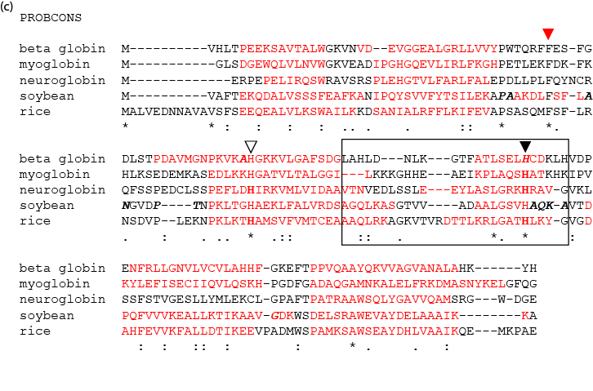
Probcons

Slide 10
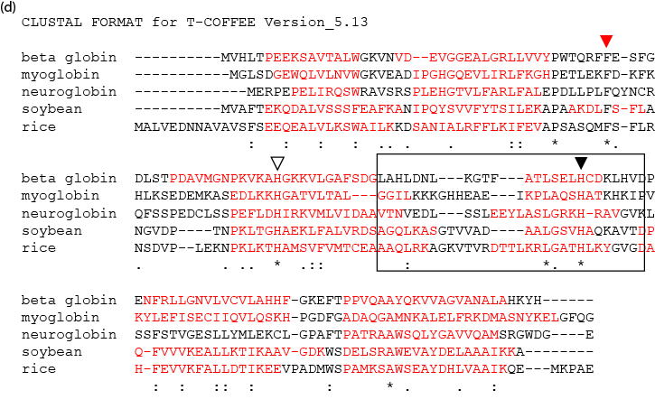
TCoffee

Slide 11
Multiple sequence alignment: properties
• not necessarily one “correct” alignment of a protein family
• protein sequences evolve...
• ...the corresponding three-dimensional structures
of proteins also evolve
• may be impossible to identify amino acid residues
that align properly (structurally) throughout a multiple
sequence alignment
• for two proteins sharing 30% amino acid identity,
about 50% of the individual amino acids
are superposable in the two structures

Slide 12
Multiple sequence alignment: features
• some aligned residues, such as cysteines that form
disulfide bridges, may be highly conserved
there may be conserved motifs such as a
transmembrane domain
there may be conserved secondary structure features
there may be regions with consistent patterns of
insertions or deletions (indels)

Slide 13
Multiple sequence alignment: uses
• MSA is more sensitive than pairwise alignment
to detect homologs
BLAST output can take the form of a MSA,
and can reveal conserved residues or motifs
A single query can be searched against
a database of MSAs (e.g. PFAM)
Regulatory regions of genes may have consensus
sequences identifiable by MSA

Slide 14
Outline: multiple sequence alignment (MSA)
Introduction; definition of MSA; typical uses
Five main approaches to multiple sequence alignment
Exact approaches
Progressive sequence alignment Iterative approaches
Consistency-based approaches
Structure-based methods Benchmarking studies: approaches, findings, challenges
Databases of Multiple Sequence Alignments
Pfam: Protein Family Database of Profile HMMs SMART Conserved Domain Database Integrated multiple sequence alignment resources MSA database curation: manual versus automated Multiple sequence alignments of genomic regions
UCSC, Galaxy, Ensembl, alignathon
Perspective

Slide 15
Multiple sequence alignment: exact methods
Exact methods of multiple alignment use dynamic programming and are guaranteed to find optimal solutions. But they are not feasible for more than a few sequences.

Slide 16
Multiple sequence alignment: methods
Progressive methods: use a guide tree (related to a
phylogenetic tree) to determine how to combine pairwise alignments one by one to create a multiple alignment.
Examples: CLUSTALW, MUSCLE

Slide 17
Multiple sequence alignment: methods
Example of MSA using ClustalW: two data sets
Five distantly related globins (human to plant)
Five closely related beta globins
Obtain your sequences in the FASTA format!
You can save them in a Word document or text editor.
Visit www.bioinfbook.org for web documents 6-3 and 6-4

Slide 18
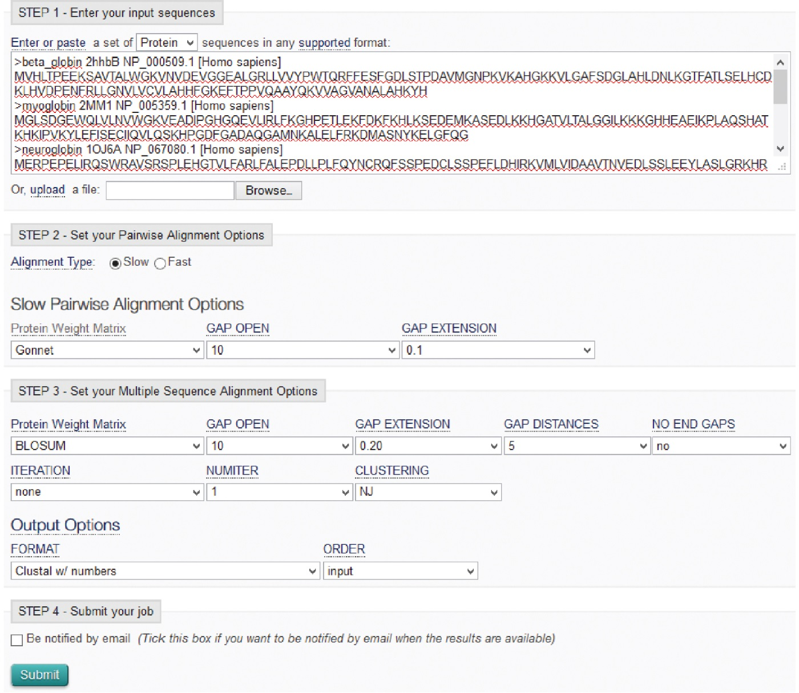
Use ClustalW to do a progressive MSA
B&FG 3e
Fig. 6.1
Page 209
http://www.ebi.ac.uk/Tools/msa/clustalw2/

Slide 19
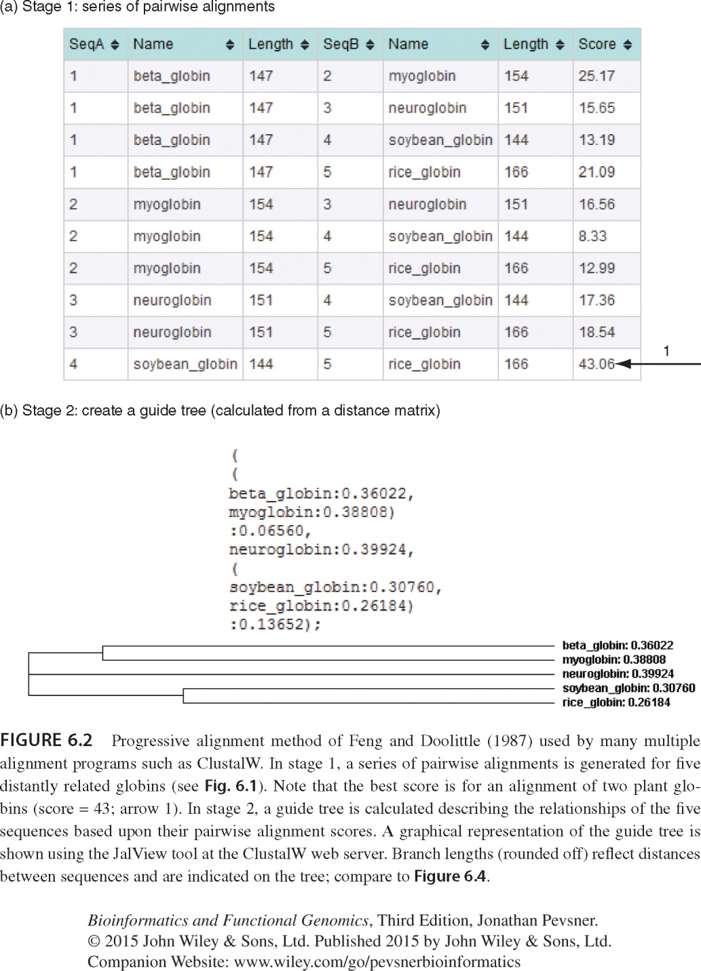
ClustalW stage 1: series of pairwise alignments
best
score
(highest percent pairwise identity)
B&FG 3e
Fig. 6.2
Page 210

Slide 20
ClustalW stage 1: series of pairwise alignments
ClustalW stage 2: create a guide tree
best
score
(highest percent pairwise identity)
Note that the two proteins with the highest percent pairwise identity (soybean and rice globin) also have the shortest connecting branch lengths in the tree
B&FG 3e
Fig. 6.2
Page 210

Slide 21
Feng-Doolittle MSA occurs in 3 stages
[1] Do a set of global pairwise alignments
(Needleman and Wunsch’s dynamic programming
algorithm)
[2] Create a guide tree
[3] Progressively align the sequences

Slide 22
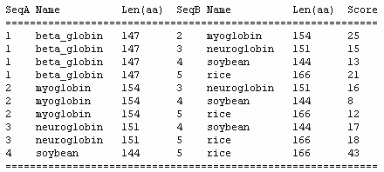
Progressive MSA stage 1 of 3:
generate global pairwise alignments
best
score

Slide 23
Number of pairwise alignments needed
For n sequences, (n-1)(n) / 2
For 5 sequences, (4)(5) / 2 = 10
For 200 sequences, (199)(200) / 2 = 19,900

Slide 24
Feng-Doolittle stage 2: guide tree
Convert similarity scores to distance scores
A tree shows the distance between objects
Use UPGMA (defined in the phylogeny chapter)
ClustalW provides a syntax to describe the tree

Slide 25
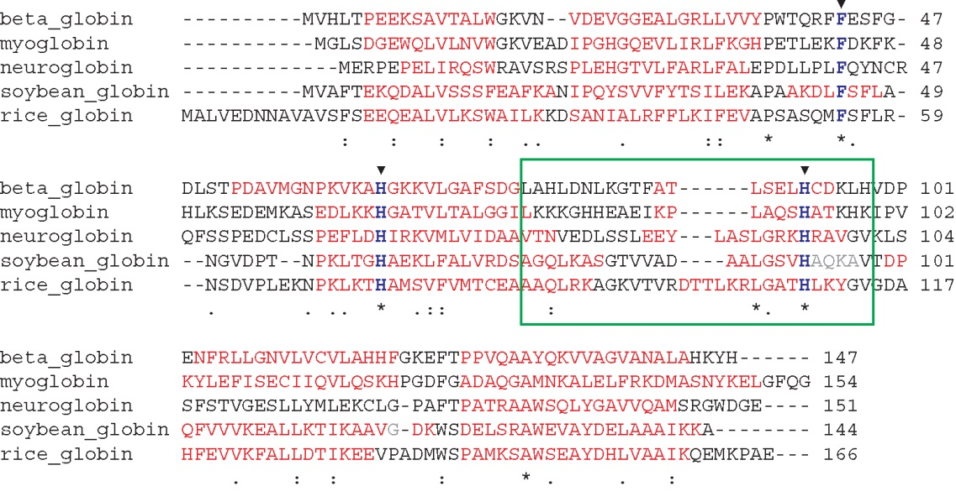
ClustalW alignment of five distantly related beta globin orthologs
B&FG 3e
Fig. 6.3
Page 211

Slide 26
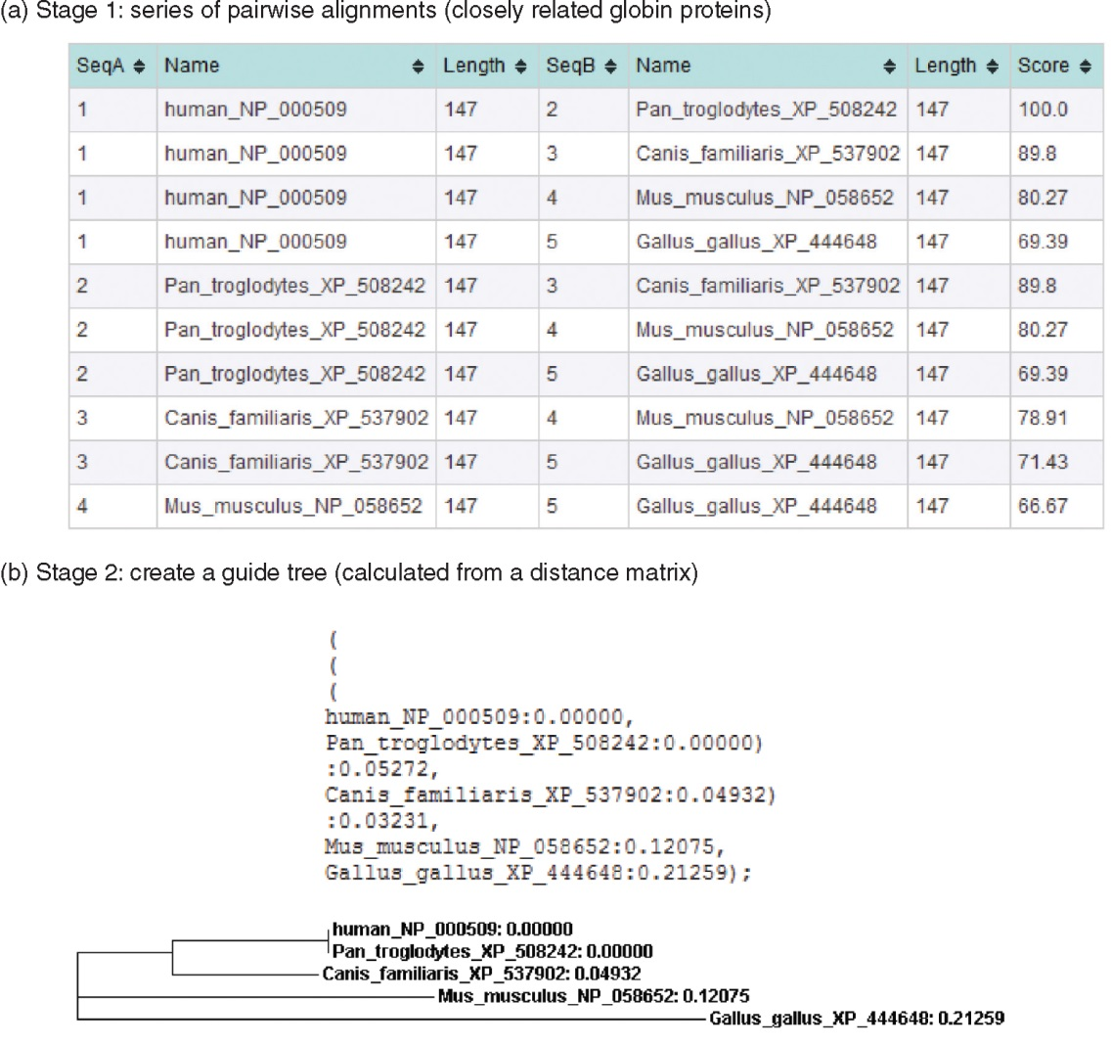
B&FG 3e
Fig. 6.4
Page 212

Slide 27
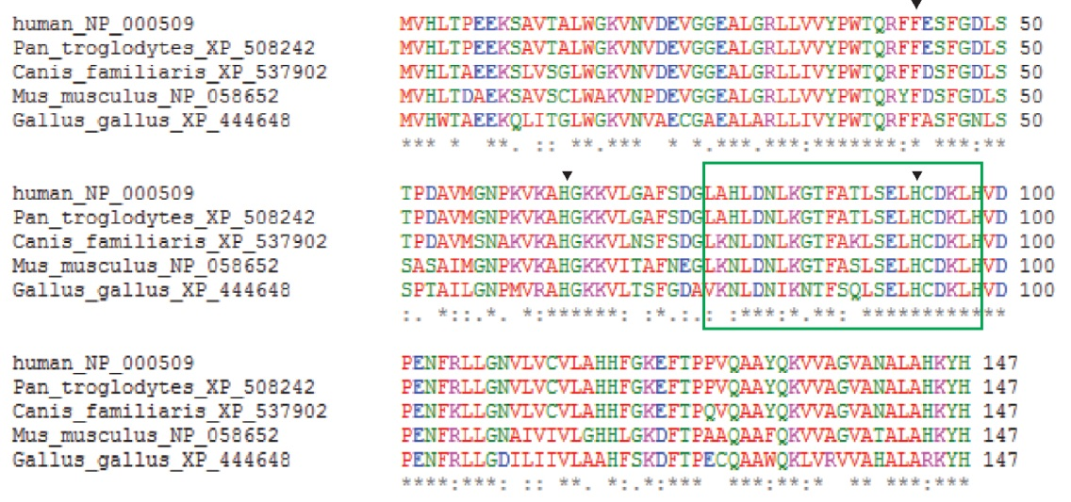
ClustalW alignment of five closely related beta globin orthologs
B&FG 3e
Fig. 6.5
Page 213

Slide 28
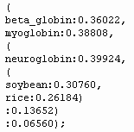
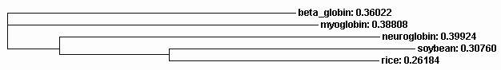
Progressive MSA stage 2 of 3:
generate a guide tree calculated from the
distance matrix (5 distantly related globins)

Slide 29
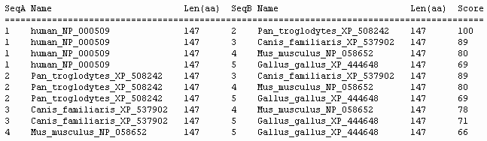
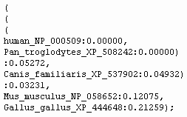
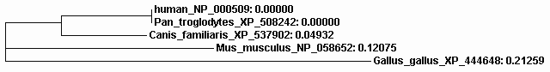
5 closely
related
globins

Slide 30
Feng-Doolittle stage 3: progressive alignment
Make a MSA based on the order in the guide tree
Start with the two most closely related sequences
Then add the next closest sequence
Continue until all sequences are added to the MSA
Rule: “once a gap, always a gap.”

Slide 31
Why “once a gap, always a gap”?
There are many possible ways to make a MSA
Where gaps are added is a critical question
Gaps are often added to the first two (closest)
sequences
To change the initial gap choices later on would be
to give more weight to distantly related sequences
To maintain the initial gap choices is to trust
that those gaps are most believable

Slide 32
Additional features of ClustalW improve
its ability to generate accurate MSAs
Individual weights are assigned to sequences;
very closely related sequences are given less weight,
while distantly related sequences are given more weight
Scoring matrices are varied dependent on the presence
of conserved or divergent sequences, e.g.:
PAM20 80-100% id
PAM60 60-80% id
PAM120 40-60% id
PAM350 0-40% id
Residue-specific gap penalties are applied

Slide 33
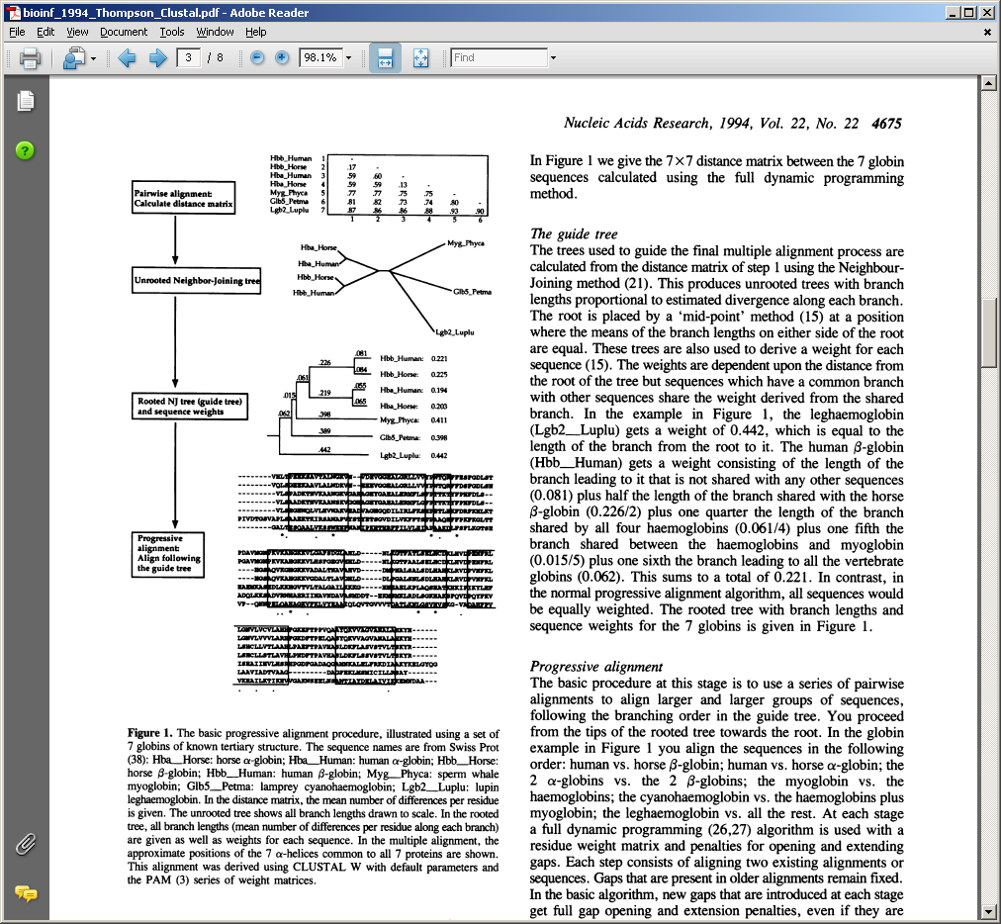
See Thompson et al. (1994) for an explanation of the three stages of progressive alignment implemented in ClustalW

Slide 34
Pairwise alignment:
Calculate distance matrix
Unrooted neighbor-
joining tree

Slide 35
Unrooted neighbor-
joining tree
Rooted neighbor-joining tree (guide tree) and sequence weights

Slide 36
Rooted neighbor-joining tree (guide tree) and sequence weights
Progressive alignment: Align following the guide tree

Slide 37
Outline: multiple sequence alignment (MSA)
Introduction; definition of MSA; typical uses
Five main approaches to multiple sequence alignment
Exact approaches
Progressive sequence alignment Iterative approaches
Consistency-based approaches
Structure-based methods Benchmarking studies: approaches, findings, challenges
Databases of Multiple Sequence Alignments
Pfam: Protein Family Database of Profile HMMs SMART Conserved Domain Database Integrated multiple sequence alignment resources MSA database curation: manual versus automated Multiple sequence alignments of genomic regions
UCSC, Galaxy, Ensembl, alignathon
Perspective

Slide 38
Iterative approaches: MAFFT
Uses Fast Fourier Transform to speed up profile alignment
Uses fast two-stage method for building alignments using k-mer frequencies
Offers many different scoring and aligning techniques
One of the more accurate programs available
Available as standalone or web interface
Many output formats, including interactive phylogenetic trees
Page 190

Slide 39
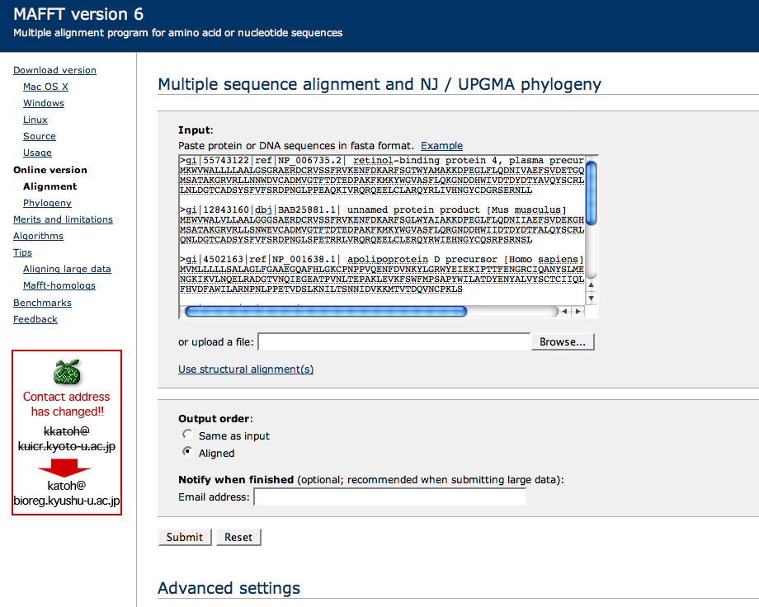
Iterative approaches: MAFFT
Has about 1000 advanced settings!

Slide 40
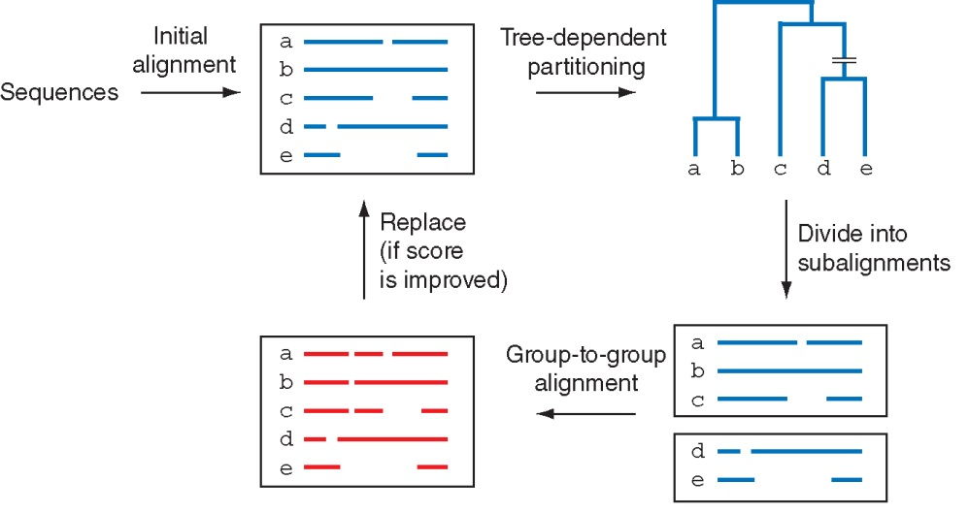
Iterative method of MAFFT
B&FG 3e
Fig. 6.6
Page 215

Slide 41
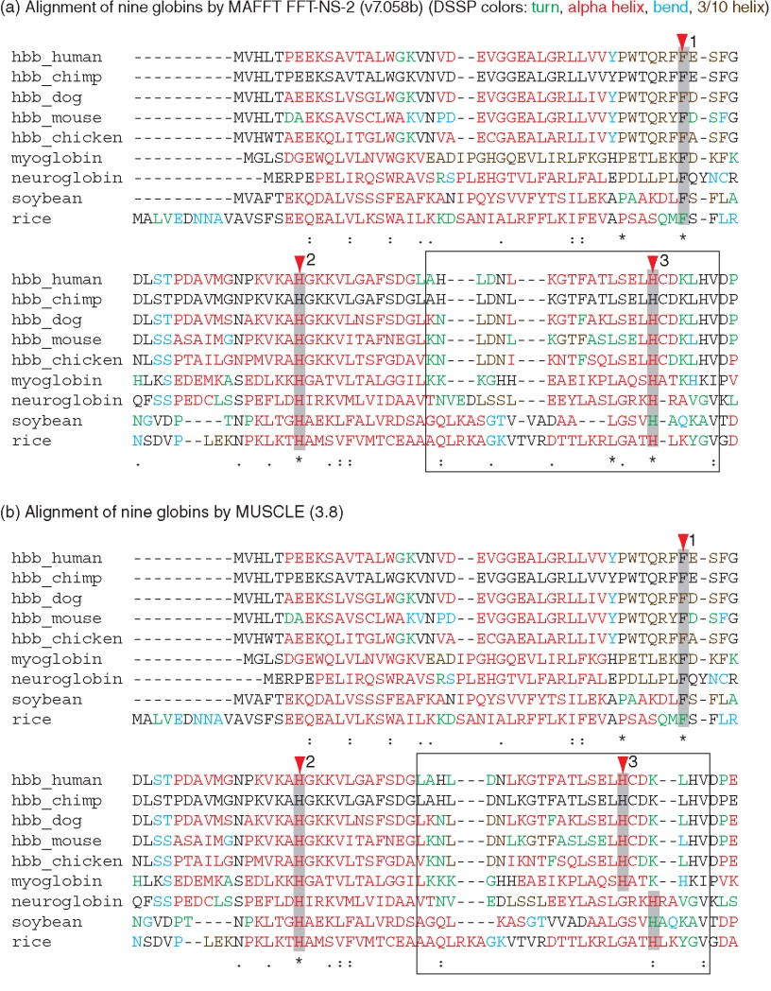
MAFFT
MUSCLE
B&FG 3e
Fig. 6.7
Page 216

Slide 42
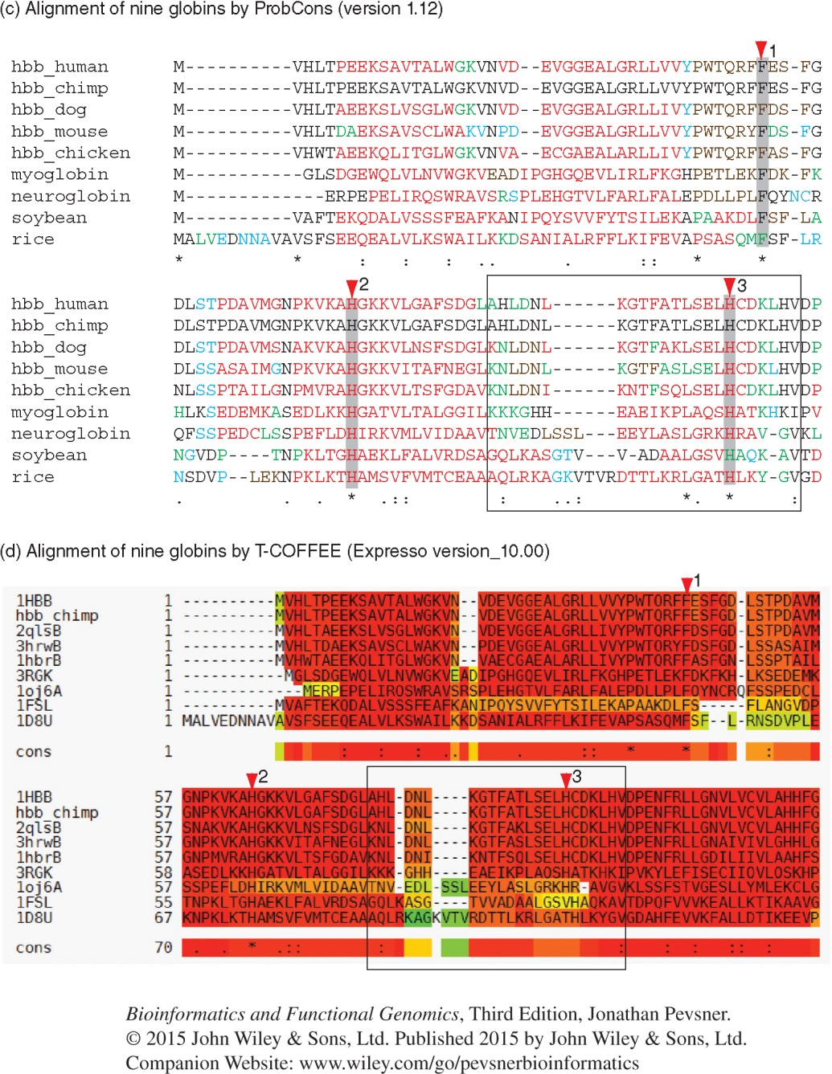
ProbCons
T-COFFEE
B&FG 3e
Fig. 6.7
Page 217

Slide 43
Multiple sequence alignment methods
Iterative methods: compute a sub-optimal solution and keep modifying that intelligently using dynamic programming or other methods until the solution converges.
Examples: MUSCLE, IterAlign, Praline, MAFFT

Slide 44
MUSCLE: next-generation progressive MSA
[1] Build a draft progressive alignment
Determine pairwise similarity through k-mer counting (not by alignment)
Compute distance (triangular distance) matrix
Construct tree using UPGMA
Construct draft progressive alignment following tree

Slide 45
MUSCLE: next-generation progressive MSA
[2] Improve the progressive alignment
Compute pairwise identity through current MSA
Construct new tree with Kimura distance measures
Compare new and old trees: if improved, repeat this step, if not improved, then we’re done

Slide 46
MUSCLE: next-generation progressive MSA
[3] Refinement of the MSA
Split tree in half by deleting one edge
Make profiles of each half of the tree
Re-align the profiles
Accept/reject the new alignment

Slide 47
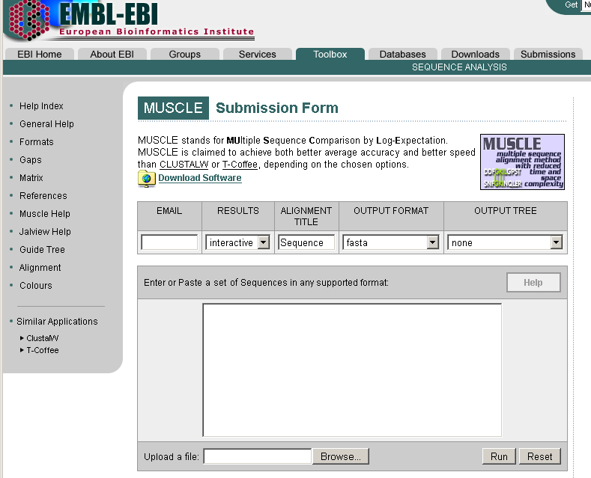
Access to MUSLCE at EBI
http://www.ebi.ac.uk/muscle/

Slide 48
Outline: multiple sequence alignment (MSA)
Introduction; definition of MSA; typical uses
Five main approaches to multiple sequence alignment
Exact approaches
Progressive sequence alignment Iterative approaches
Consistency-based approaches
Structure-based methods Benchmarking studies: approaches, findings, challenges
Databases of Multiple Sequence Alignments
Pfam: Protein Family Database of Profile HMMs SMART Conserved Domain Database Integrated multiple sequence alignment resources MSA database curation: manual versus automated Multiple sequence alignments of genomic regions
UCSC, Galaxy, Ensembl, alignathon
Perspective

Slide 49
Multiple sequence alignment: consistency
Consistency-based algorithms: generally use a database of both local high-scoring alignments and long-range global alignments to create a final alignment
These are very powerful, very fast, and very accurate methods
Examples: T-COFFEE, Prrp, DiAlign, ProbCons

Slide 50
ProbCons—consistency-based approach
Combines iterative and progressive approaches with a unique probabilistic model.
Uses Hidden Markov Models to calculate probability matrices for matching residues, uses this to construct a guide tree
Progressive alignment hierarchically along guide tree
Post-processing and iterative refinement (a little like MUSCLE)

Slide 51
ProbCons—consistency-based approach
Sequence x x_{i}
Sequence y y_{j}
Sequence z z_{k}
If x_{i} aligns with z_{k}
and z_{k} aligns with y_{j}
then x_{i} should align with y_{j}
ProbCons incorporates evidence from multiple sequences to guide the creation of a pairwise alignment.

Slide 52
ProbCons output for the same alignment:
consistency iteration helps

Slide 53
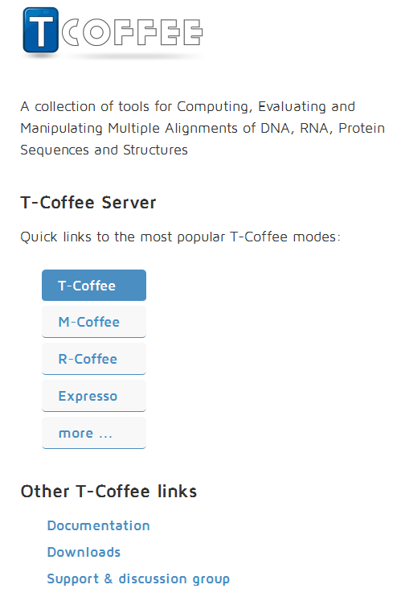
Access to TCoffee:
http://tcoffee.org
--Make a MSA
--MSA w. structural data
--Compare MSA methods
--Make an RNA MSA
--Combine MSA methods
--Consistency-based
--Structure-based

Slide 54
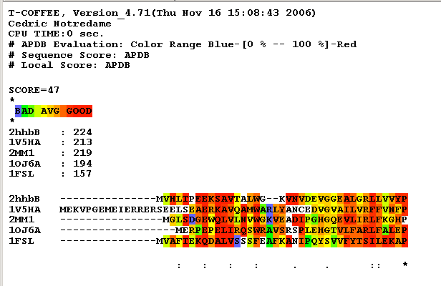
APDB ClustalW output: TCoffee can incorporate structural information into a MSA
Protein Data Bank accession numbers

Slide 55
Outline: multiple sequence alignment (MSA)
Introduction; definition of MSA; typical uses
Five main approaches to multiple sequence alignment
Exact approaches
Progressive sequence alignment Iterative approaches
Consistency-based approaches
Structure-based methods Benchmarking studies: approaches, findings, challenges
Databases of Multiple Sequence Alignments
Pfam: Protein Family Database of Profile HMMs SMART Conserved Domain Database Integrated multiple sequence alignment resources MSA database curation: manual versus automated Multiple sequence alignments of genomic regions
UCSC, Galaxy, Ensembl, alignathon
Perspective

Slide 56
Multiple sequence alignment: methods
How do we know which program to use?
There are benchmarking multiple alignment datasets that have been aligned painstakingly by hand, by structural similarity, or by extremely time- and memory-intensive automated exact algorithms.
Some programs have interfaces that are more user-friendly than others. And most programs are excellent so it depends on your preference.
If your proteins have 3D structures, use these to help you judge your alignments. For example, try Expresso at http://www.tcoffee.org.

Slide 57
Strategy for assessment of alternative
multiple sequence alignment algorithms
[1] Create or obtain a database of protein sequences
for which the 3D structure is known. Thus we can
define “true” homologs using structural criteria.
[2] Try making multiple sequence alignments
with many different sets of proteins (very related,
very distant, few gaps, many gaps, insertions, outliers).
[3] Compare the answers.

Slide 58
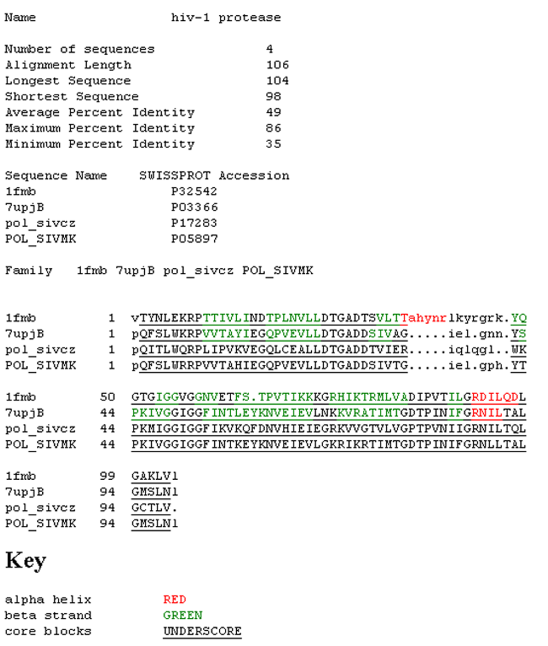
BaliBase: comparison
of multiple sequence
alignment algorithms

Slide 59
Multiple sequence alignment: methods
Benchmarking tests suggest that ProbCons, a consistency-based/progressive algorithm, performs the best on the BAliBASE set, although MUSCLE, a progressive alignment package, is an extremely fast and accurate program.
ClustalW has been the most popular program. It has a nice interface (especially with ClustalX) and is easy to use. But several programs perform better. There is no one single best program to use, and your answers will certainly differ (especially if you align divergent protein or DNA sequences)

Slide 60
Outline: multiple sequence alignment (MSA)
Introduction; definition of MSA; typical uses
Five main approaches to multiple sequence alignment
Exact approaches
Progressive sequence alignment Iterative approaches
Consistency-based approaches
Structure-based methods Benchmarking studies: approaches, findings, challenges
Databases of Multiple Sequence Alignments
Pfam: Protein Family Database of Profile HMMs SMART Conserved Domain Database Integrated multiple sequence alignment resources MSA database curation: manual versus automated Multiple sequence alignments of genomic regions
UCSC, Galaxy, Ensembl, alignathon
Perspective

Slide 61
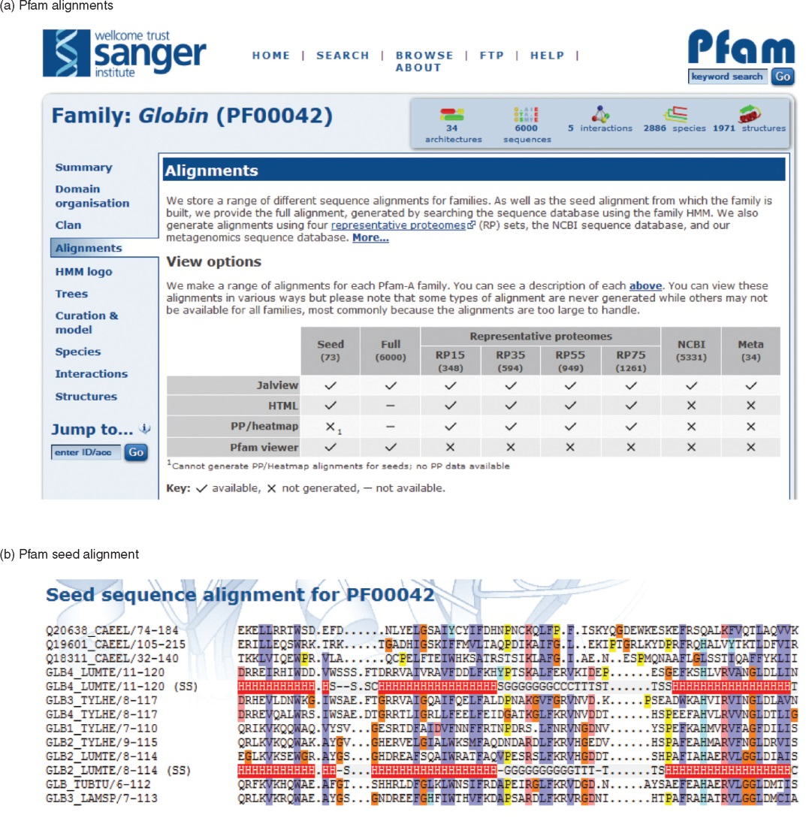
B&FG 3e
Fig. 6.8
Page 225

Slide 62
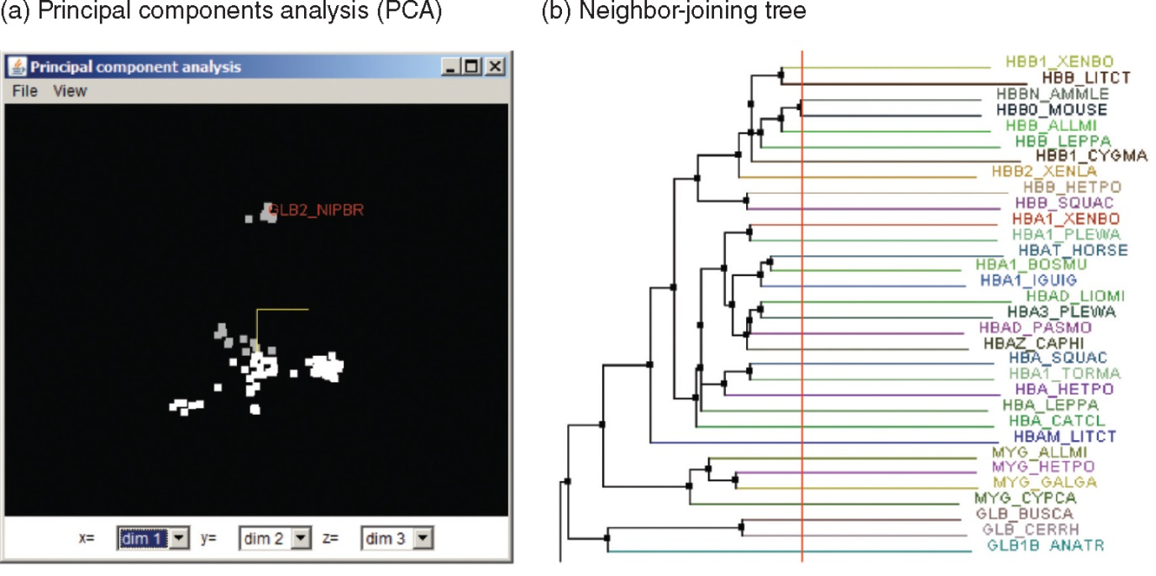
Pfam alignment retrieved in the JalView Java viewer
B&FG 3e
Fig. 6.9
Page 226

Slide 63
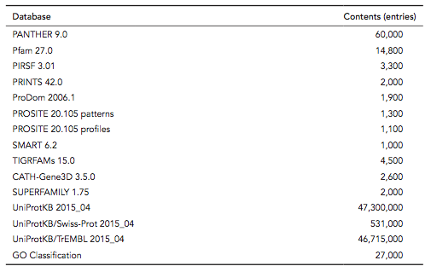
Databases on which Interpro (release 51.0) is based
B&FG 3e
Table 6.1
Page 227
http://www.ebi.ac.uk/interpro/release_notes.html

Slide 64
Outline: multiple sequence alignment (MSA)
Introduction; definition of MSA; typical uses
Five main approaches to multiple sequence alignment
Exact approaches
Progressive sequence alignment Iterative approaches
Consistency-based approaches
Structure-based methods Benchmarking studies: approaches, findings, challenges
Databases of Multiple Sequence Alignments
Pfam: Protein Family Database of Profile HMMs SMART Conserved Domain Database Integrated multiple sequence alignment resources MSA database curation: manual versus automated Multiple sequence alignments of genomic regions
UCSC, Galaxy, Ensembl, alignathon
Perspective

Slide 65
Multiple sequence alignment of genomic DNA
There are typically few sequences (up to several dozen), each having up to millions of base pairs. Adding more species improves accuracy.
Alignment of divergent sequences often reveals islands of conservation (providing “anchors” for alignment).
Chromosomes are subject to inversions, duplications, deletions, and translocations (often involving millions of base pairs). E.g. human chromosome 2 is derived from the fusion of two acrocentric chromosomes.
There are no benchmark datasets available.

Slide 66
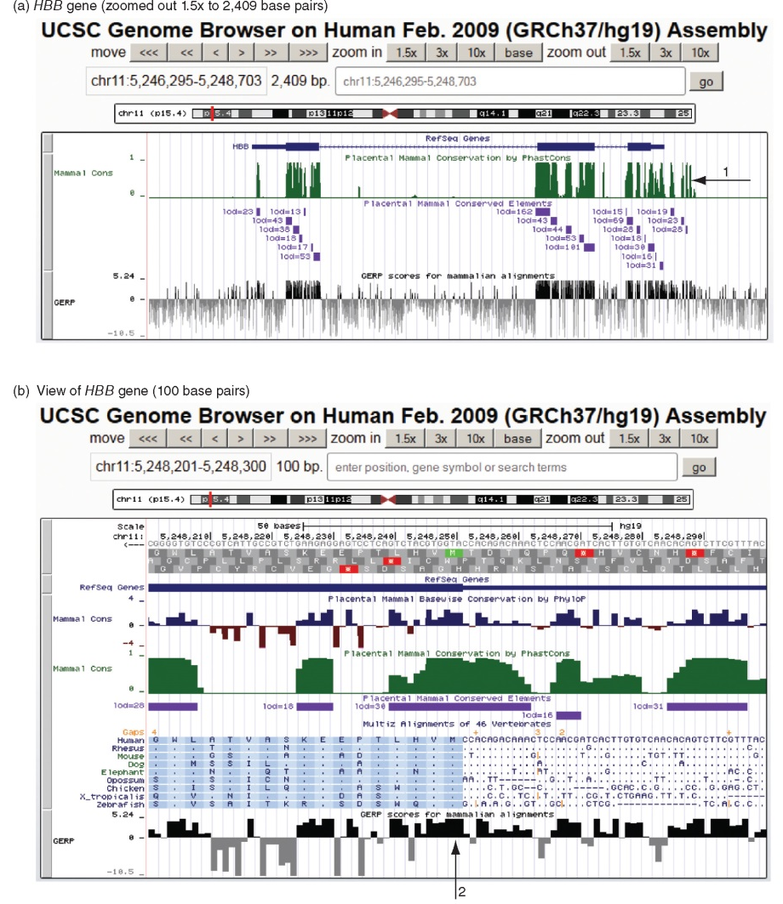
B&FG 3e
Fig. 6.10
Page 230

Slide 67
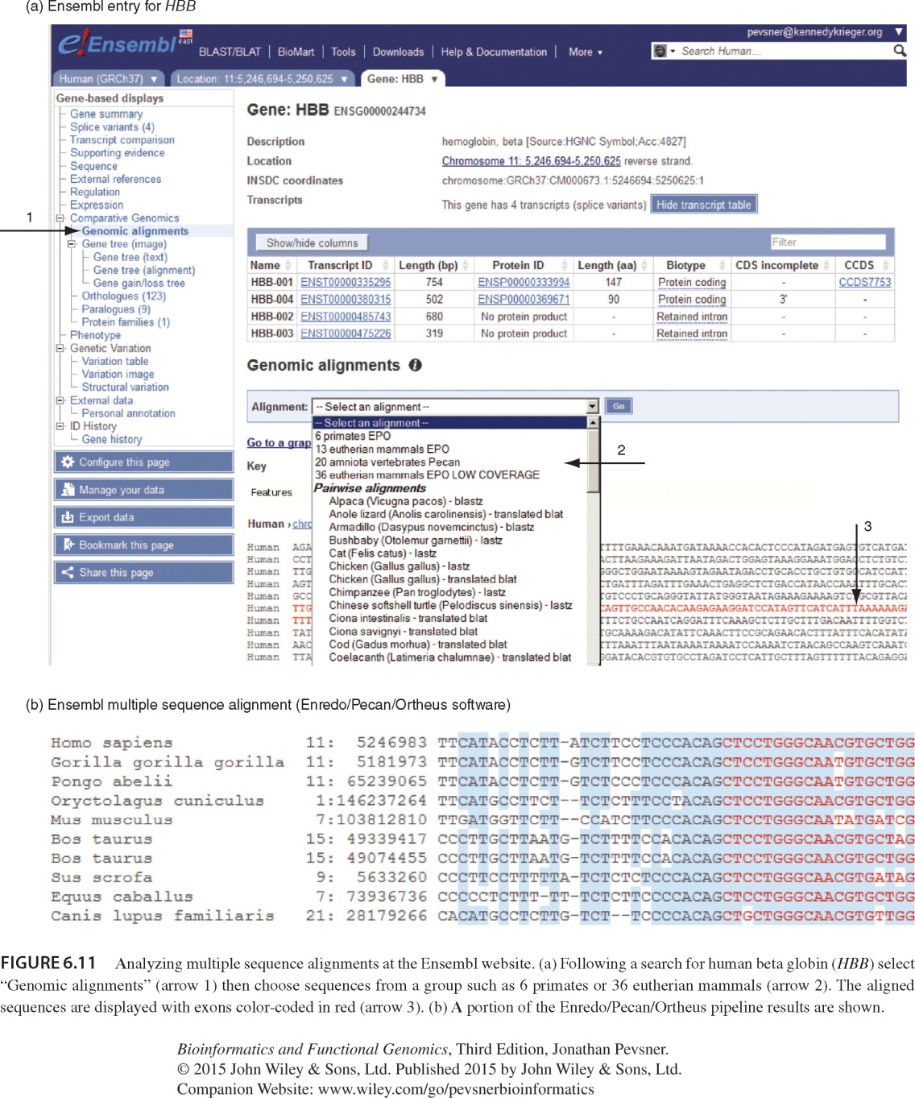
Analyzing multiple sequence alignments at Ensembl
B&FG 3e
Fig. 6.11
Page 232

Slide 68
Analyzing multiple sequence alignments at Ensembl
B&FG 3e
Fig. 6.11
Page 232

Slide 69
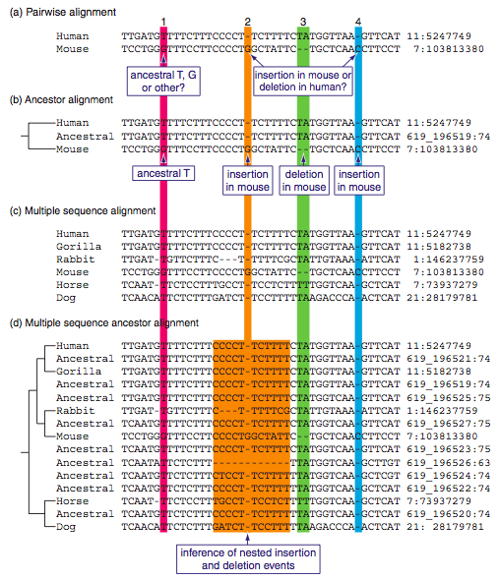
B&FG 3e
Fig. 6.12
Page 233

Slide 70
Outline: multiple sequence alignment (MSA)
Introduction; definition of MSA; typical uses
Five main approaches to multiple sequence alignment
Exact approaches
Progressive sequence alignment Iterative approaches
Consistency-based approaches
Structure-based methods Benchmarking studies: approaches, findings, challenges
Databases of Multiple Sequence Alignments
Pfam: Protein Family Database of Profile HMMs SMART Conserved Domain Database Integrated multiple sequence alignment resources MSA database curation: manual versus automated Multiple sequence alignments of genomic regions
UCSC, Galaxy, Ensembl, alignathon
Perspective

Slide 71
Perspective: multiple sequence alignment (MSA)
Many dozens of MSA programs have been introduced in recent years. None is optimal. Each offers unique strengths and weaknesses.
Key methods include consistency-, iterative-, and structure-based multiple alignment.
Alignment of genomic DNA presents specialized challenges and different sets of tools. MSA are readily available through genome browsers such as Ensembl, UCSC, and NCBI.
B&FG 3e
Page 234

